Slide 1
Peak Elevation Angle of the Sun
From Different Locations on the Earth
on Different Days in a Year

Slide 2
21st of Dec.
21st of March
21st of June
21st of Sept.
21st of Dec.

Slide 3
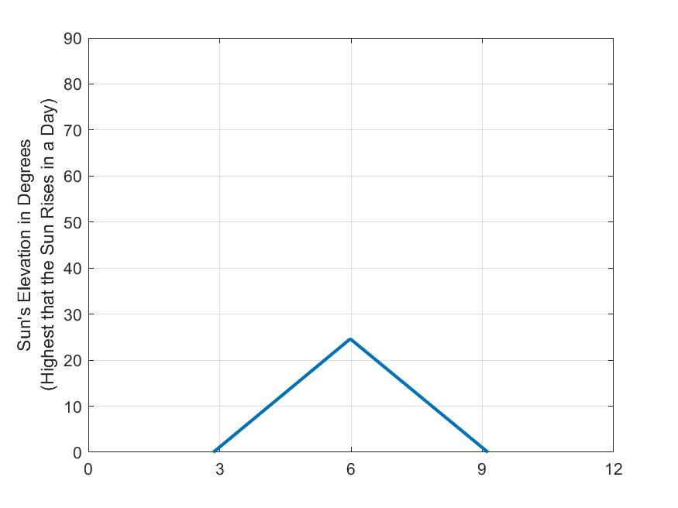

At North Pole
${90}^{o}$ N
21st of Dec.
21st of March
21st of June
21st of Sept.
21st of Dec.

Slide 4
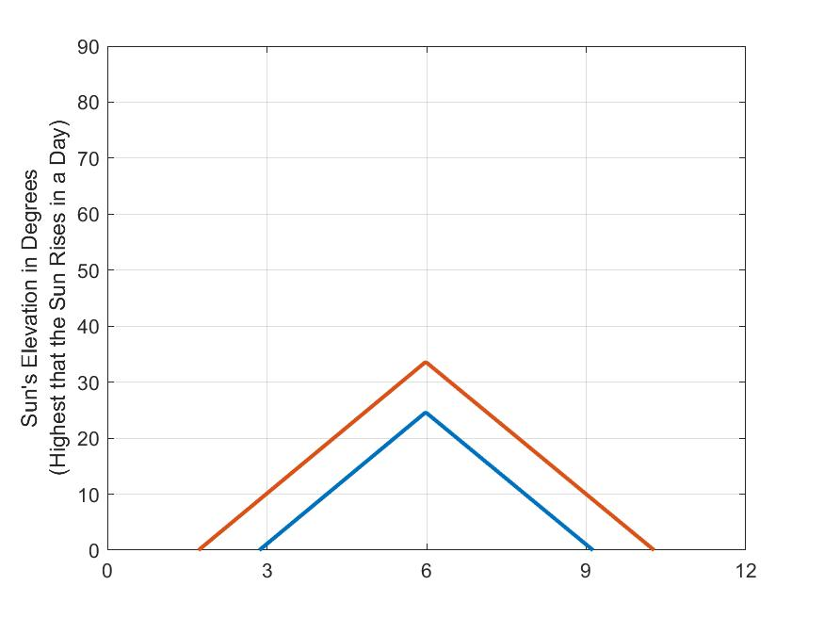

Svalbard, Norway
${80}^{o}$ N
21st of Dec.
21st of March
21st of June
21st of Sept.
21st of Dec.

Slide 5
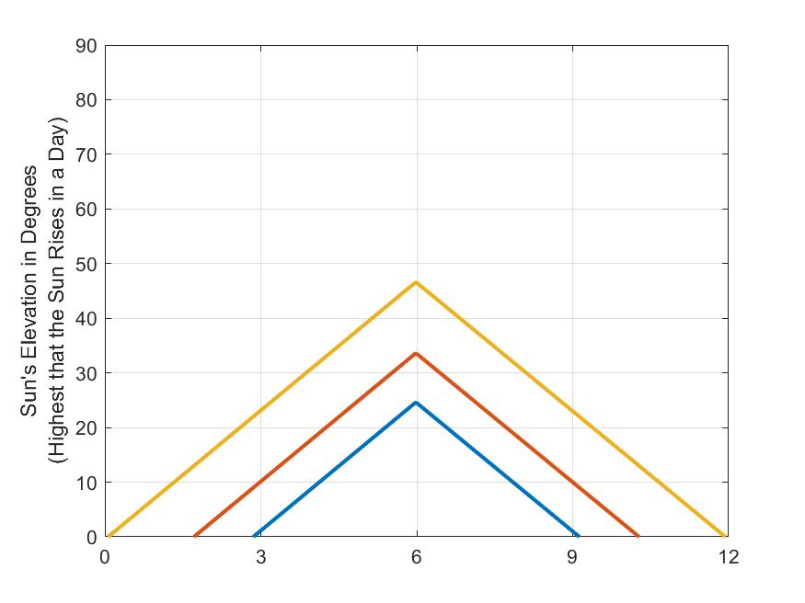

Arctic Circle
(Norway, Finland, Alaska,
Russia)
${67}^{o}$ N
21st of Dec.
21st of March
21st of June
21st of Sept.
21st of Dec.

Slide 6
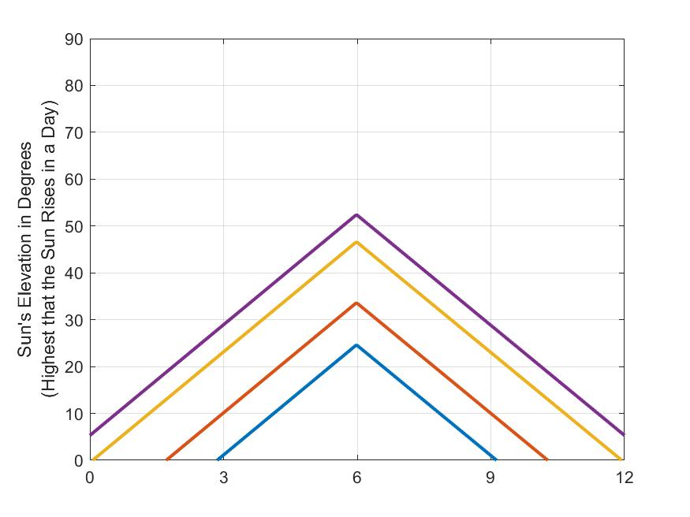

Anchorage, Alaska
${61.2}^{o}$ N
21st of Dec.
21st of March
21st of June
21st of Sept.
21st of Dec.

Slide 7
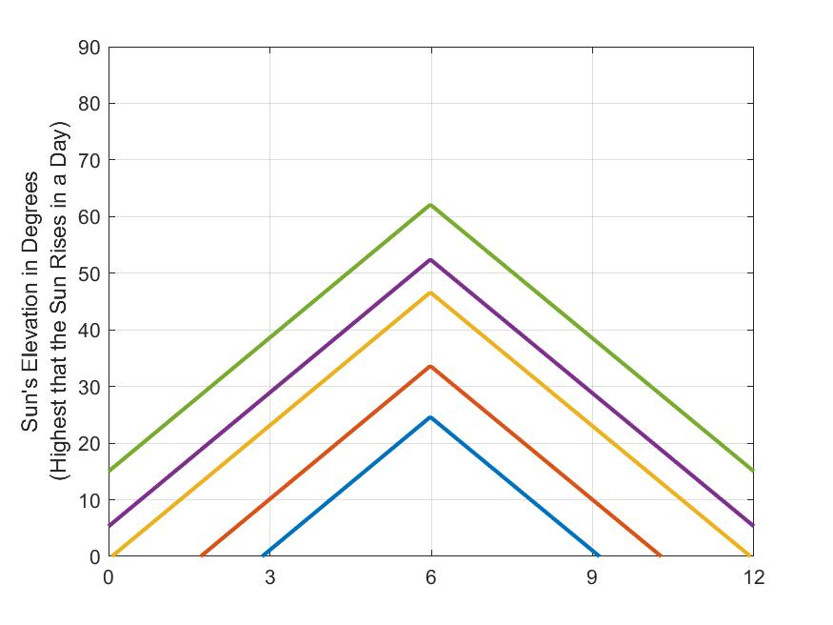

London
${51.5}^{o}$ N
21st of Dec.
21st of March
21st of June
21st of Sept.
21st of Dec.

Slide 8
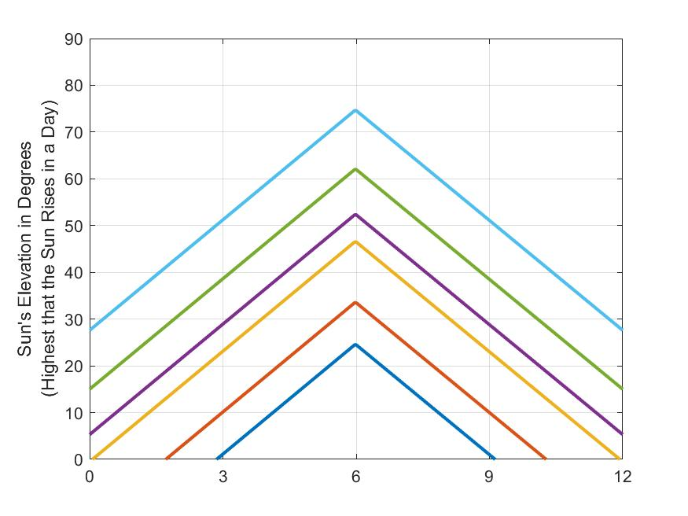

Washington DC
${38.9}^{o}$ N
21st of Dec.
21st of March
21st of June
21st of Sept.
21st of Dec.

Slide 9
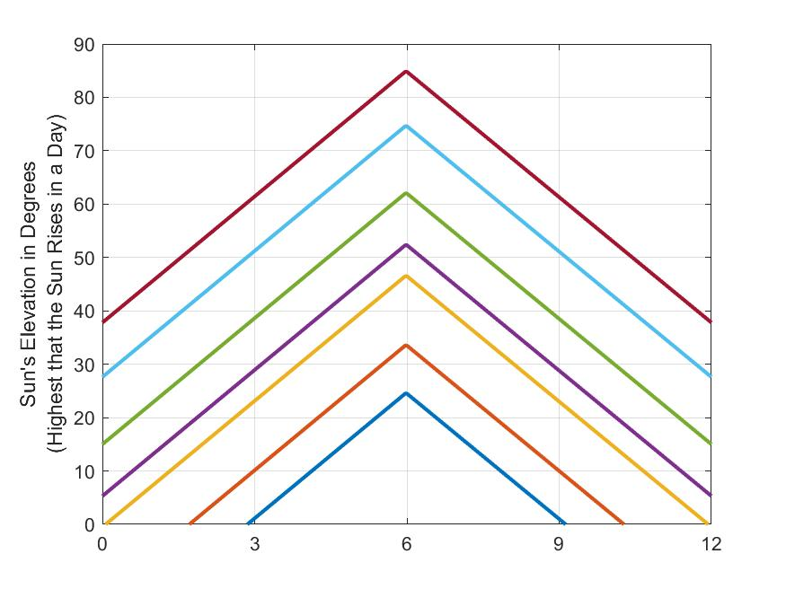

New Delhi
${28.7}^{o}$ N
21st of Dec.
21st of March
21st of June
21st of Sept.
21st of Dec.

Slide 10
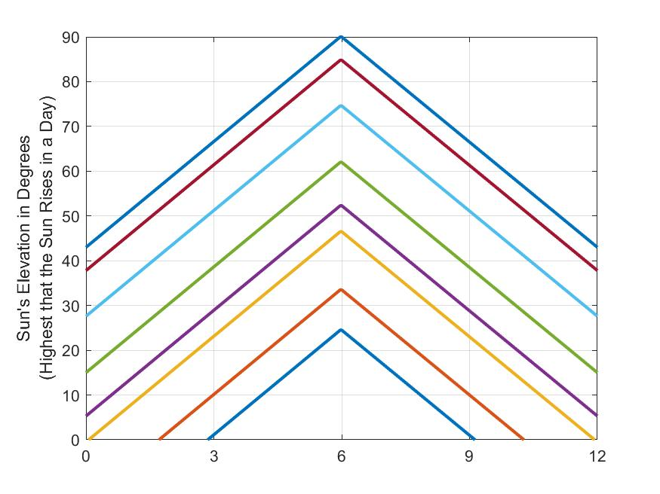

Gandhinagar
${23.5}^{o}$ N
21st of Dec.
21st of March
21st of June
21st of Sept.
21st of Dec.

Slide 11

At Equator
Kenya,
Uganda,
Indonesia,
Brazil,
Columbia
What will this look like?
$0^{o}$ N
21st of Dec.
21st of March
21st of June
21st of Sept.
21st of Dec.

Slide 12
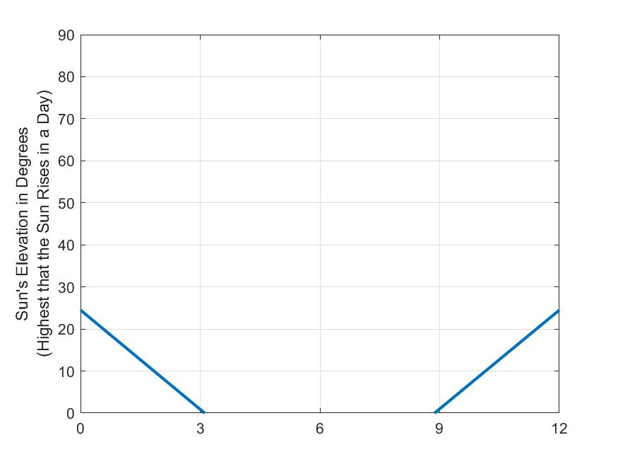

${90}^{o}$ S
21st of Dec.
21st of March
21st of June
21st of Sept.
21st of Dec.

Slide 13
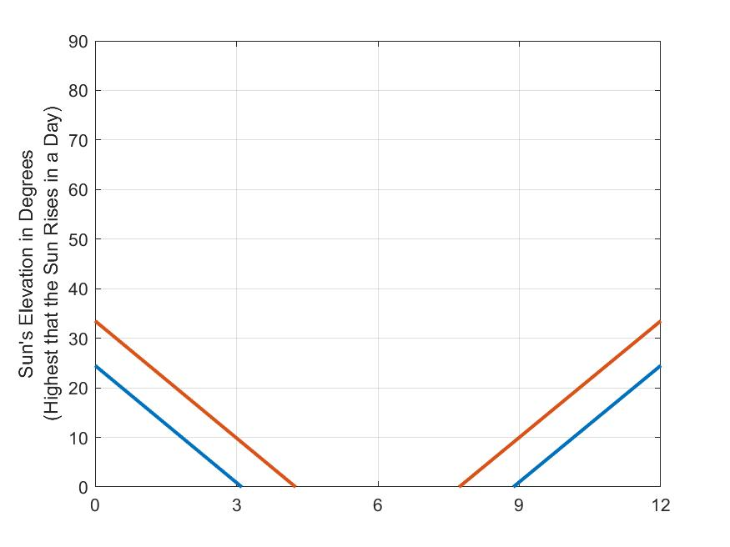

${80}^{o}$ S
21st of Dec.
21st of March
21st of June
21st of Sept.
21st of Dec.

Slide 14
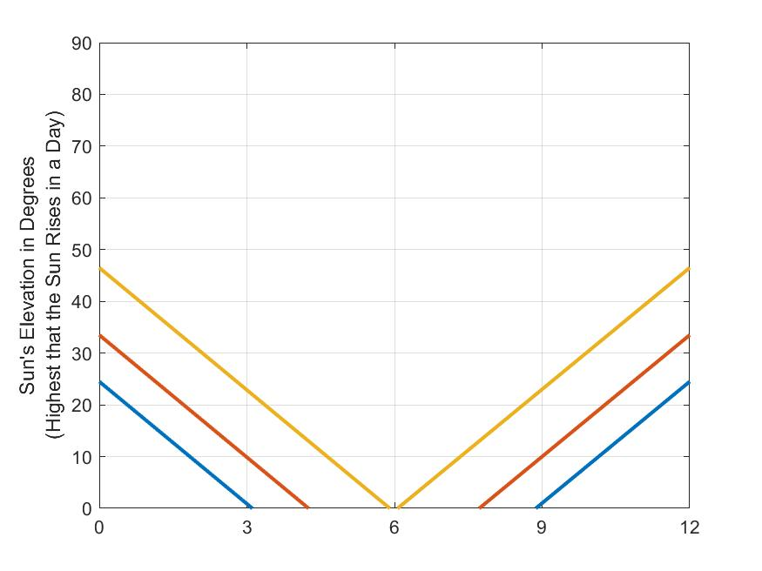

${67}^{o}$ S
21st of Dec.
21st of March
21st of June
21st of Sept.
21st of Dec.

Slide 15
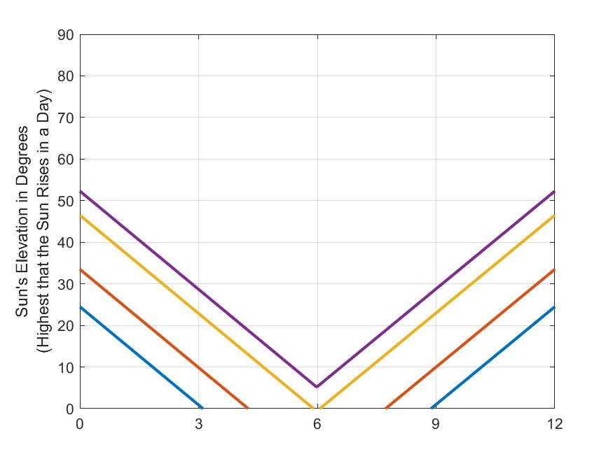

${61.2}^{o}$ S
21st of Dec.
21st of March
21st of June
21st of Sept.
21st of Dec.

Slide 16
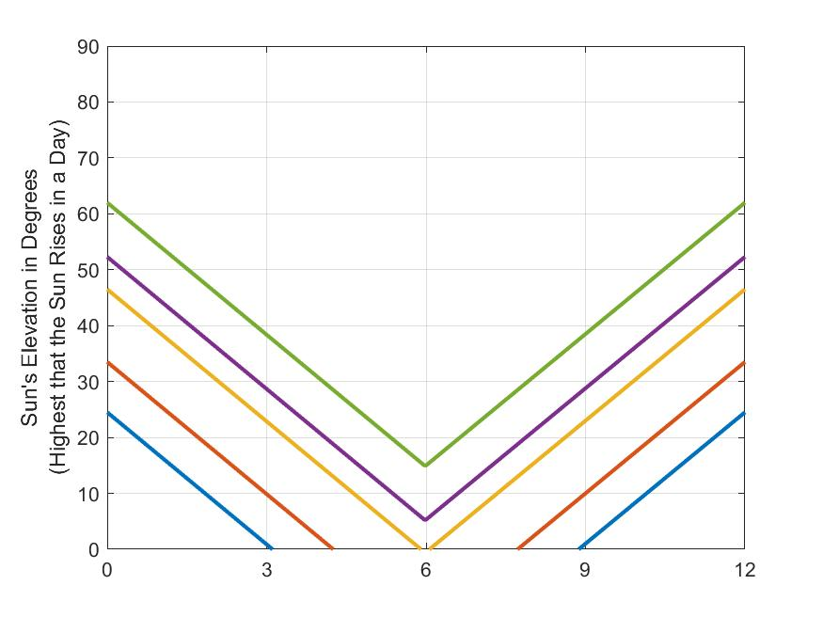

${51.5}^{o}$ S
21st of Dec.
21st of March
21st of June
21st of Sept.
21st of Dec.

Slide 17
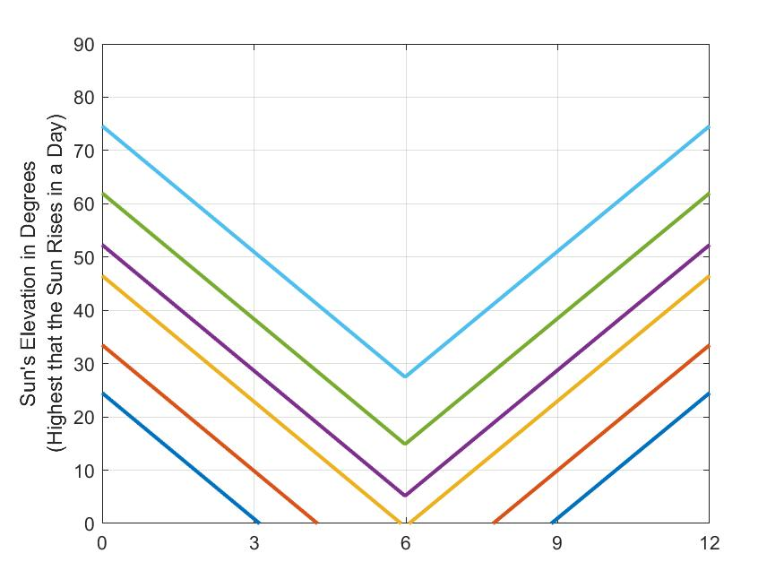

${38.9}^{o}$ S
21st of Dec.
21st of March
21st of June
21st of Sept.
21st of Dec.

Slide 18
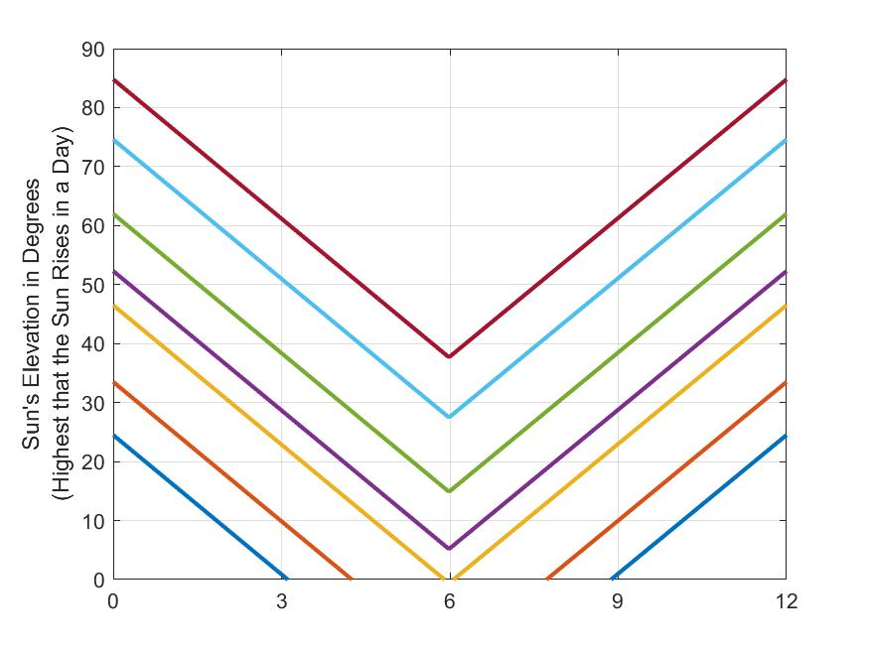

${28.7}^{o}$ S
21st of Dec.
21st of March
21st of June
21st of Sept.
21st of Dec.

Slide 19
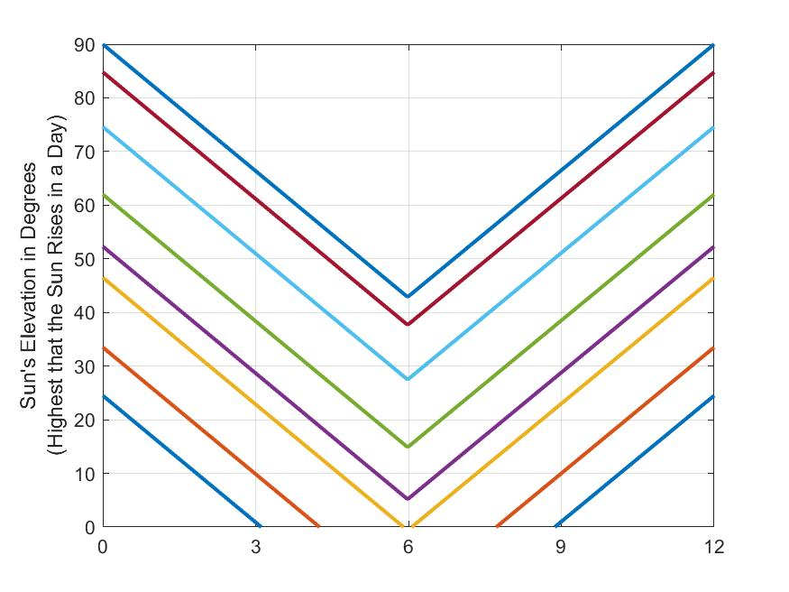

${23.5}^{o}$ S
21st of Dec.
21st of March
21st of June
21st of Sept.
21st of Dec.

Slide 20

What will this look like?
$0^{o}$ N/S
21st of Dec.
21st of March
21st of June
21st of Sept.
21st of Dec.

